Slide 1
SEQUENCE DATABASES

Slide 2
BIOINFORMATICS
In biology, bioinformatics is defined as, “the use of computer to store, retrieve, analyse or predict the composition or structure of bio-molecules” . Bioinformatics is the application of computational techniques and information technology to the organisation and management of biological data. Classical bioinformatics deals primarily with sequence analysis.
A range of information like biological sequences, structures, binding sites, metabolic interactions, molecular action, functional relationships, protein families, motifs and homologous can be retrieved by using biological databases. The main purpose of a biological database is to store and manage biological data and information in computer readable forms.

Slide 3
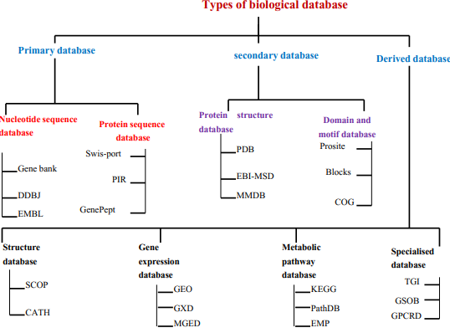

Slide 4
EXAMPLES
Primary databases
These are the primary sources of data used to store nucleic acid, protein sequences and structural information of biological macromolecules
Ex:
NCBI (National center for biotechnology information)
GenBank
DDBJ (DNA Databank of Japan)
Swiss-Prot (protein database)

Slide 5
Secondary database
Contains information derived from the analysis of data available in primary sources
Ex:
BOLD
TAIR
Pfam
CATH

Slide 6
NCBI- National center for biotechnology information
Created in 1988 as a part of national library of medicine at NIH
Establishes public databases for DNA, RNA and proteins
Develops software tools for sequence analysis
Disseminate biomedical information

Slide 7
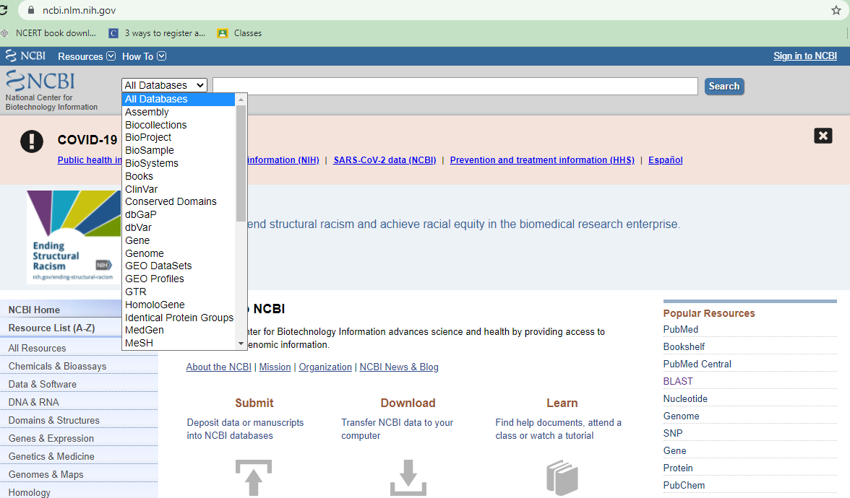

Slide 8
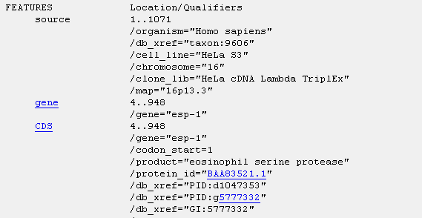
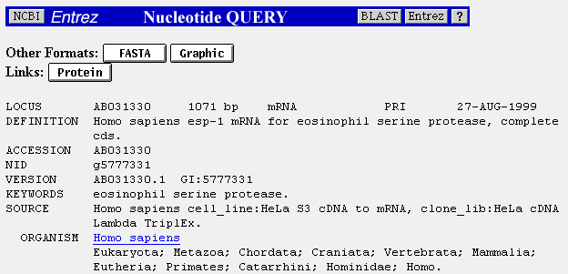
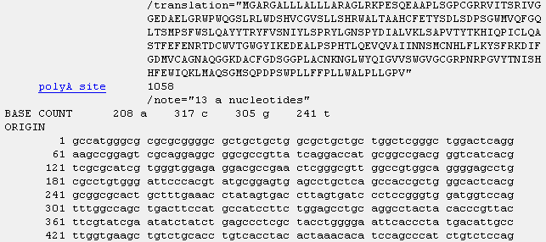
GenBank- Genetic sequence database
Gene sequence database at NCBI
Established in 1982
New DNA sequences can be deposited here and it gives a unique ID for your deposited sequence after verification of your credentials
It has sequences of more than 2,40,000 organisms, from individual labs and batch submissions from large scale projects

Slide 9
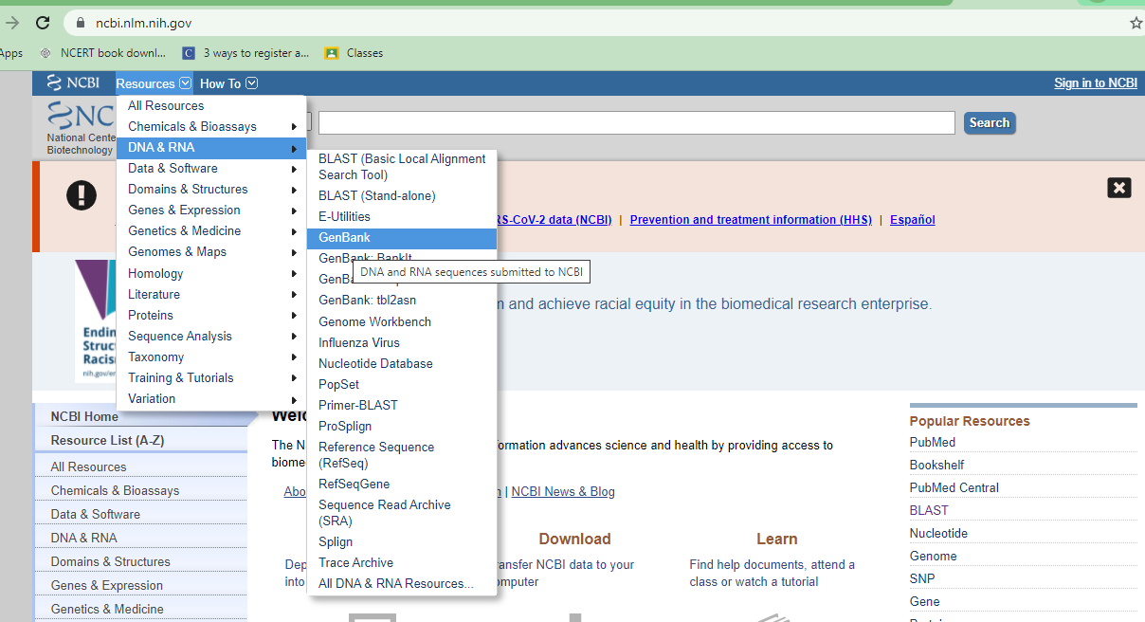

Slide 10
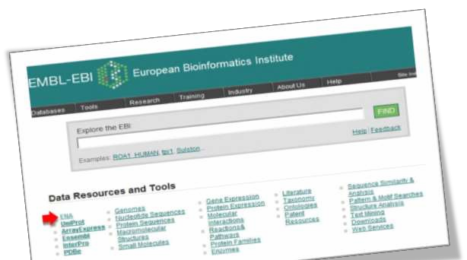
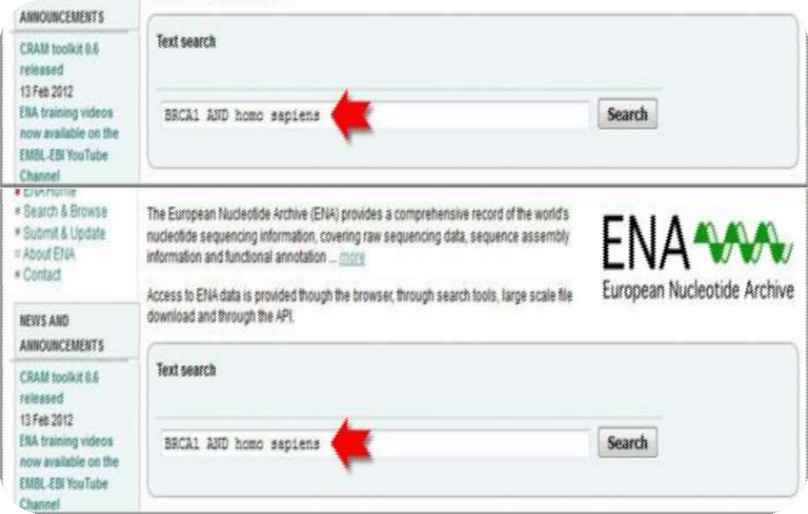
EMBL- European molecular biology laboratory
Established in 1924
European states and Israel
Produced in collaboration with DDBJ and GenBank
Search engine – SRS (Sequence Retrieval System)

Slide 11

DDBJ
◆ DNA Databank of Japan
◆ Started in 1986 in collaboration with GenBank
◆ Produced and maintained at NIG (National Institute of Genetics)

Slide 12
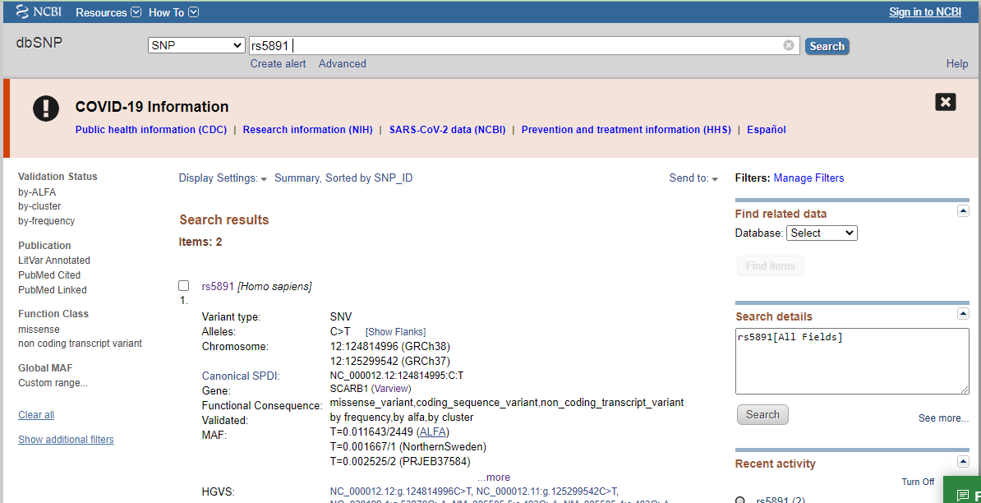
dbSNP from NCBI (Single nucleotide polymorphism)

Slide 13
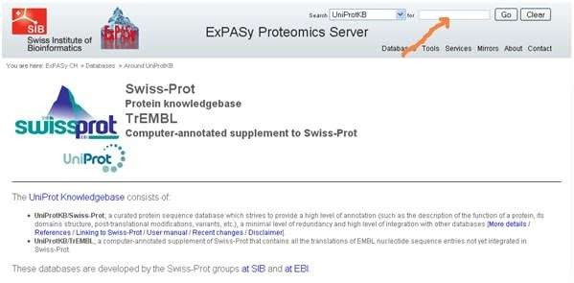
SWISS PROT
Annotated sequence database established in 1986
Consists of sequence entries of different formats
Similar format to EMBL
http://us.expasy.org/sprot/sprot-top.html
…...

Slide 14
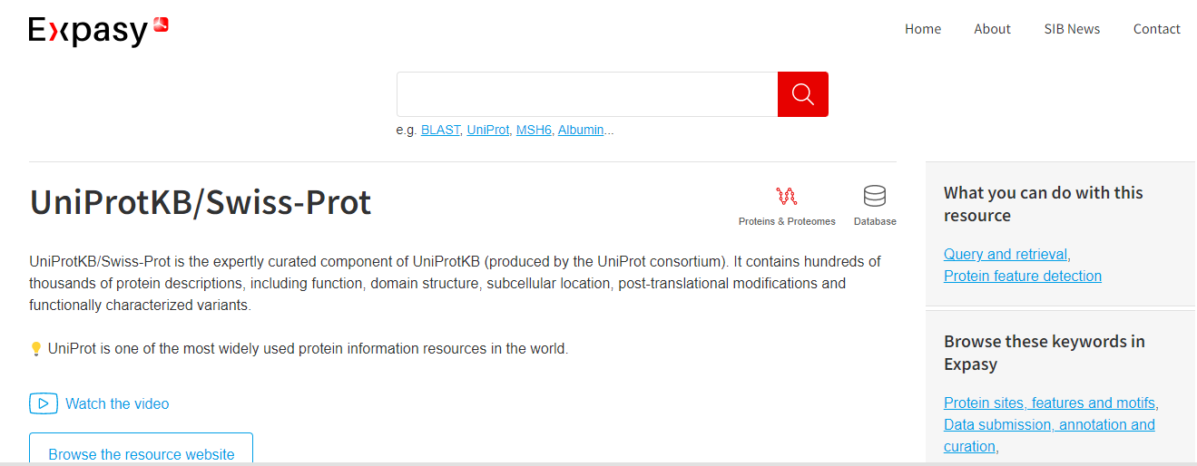

Slide 15

STRUCTURE DATABASES
PROTEIN DATA BANK

Slide 16
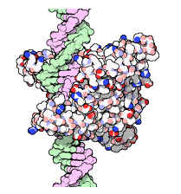
Protein DataBank (PDB)
Important in solving real problems in molecular biology
Protein Databank
PDB Established in 1972 at Brookhaven National Laboratory (BNL)
Sole international repository of macromolecular structure data
Moved to Research Collaboratory
for Structural Bioinformatics
http://www.rcsb.org/

Slide 17
The Protein Data Bank (PDB) is a database for the three-dimensional structural data of large biological molecules, such as proteins and nucleic acids. The data, typically obtained by X-ray crystallography, NMR spectroscopy, or, increasingly, cryo-electron microscopy, and submitted by biologists and biochemists from around the world, are freely accessible on the Internet via the websites of its member organisations (PDBe, PDBj, RCSB, and BMRB). The PDB is overseen by an organization called the Worldwide Protein Data Bank, wwPDB.
Members
1. RCSB (Research Collaboratory for Structural Bioinformatics), USA
2. PDBj (Osaka University), Japan
3. Macromolecular Structure Database (EBI), Europe
4. BMRB (Biological Magnetic Resonance Data Bank), USA

Slide 18
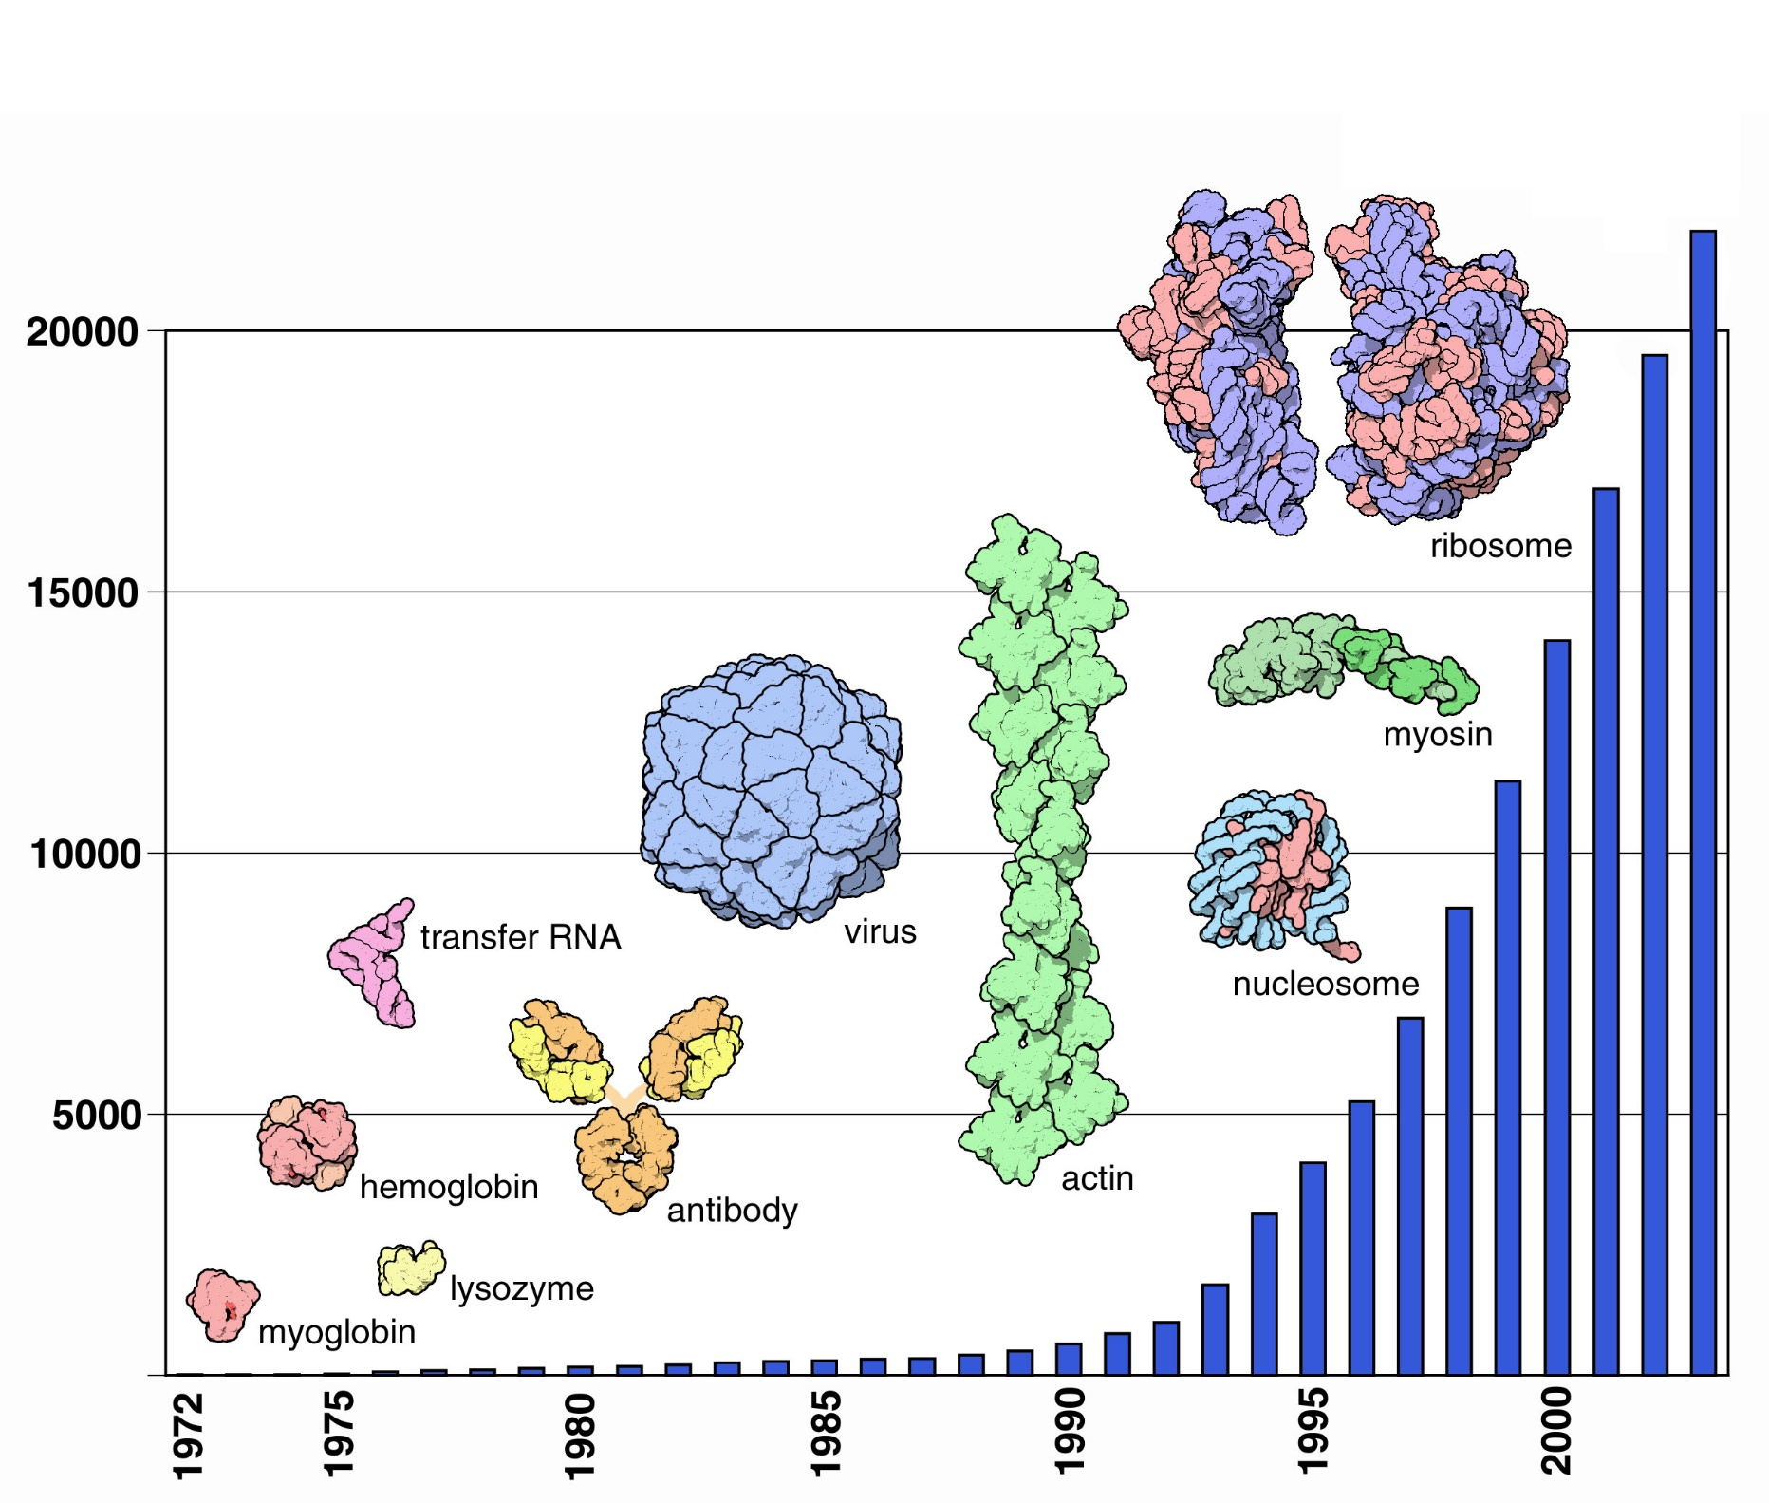
Number of released entries

Slide 19
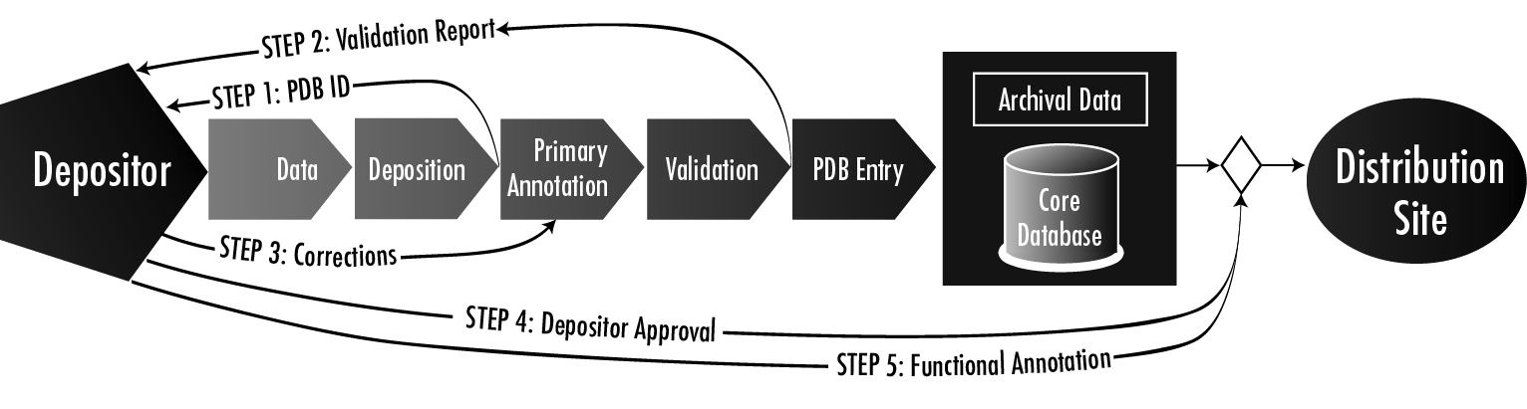
Data Processing Data Flow

Slide 20
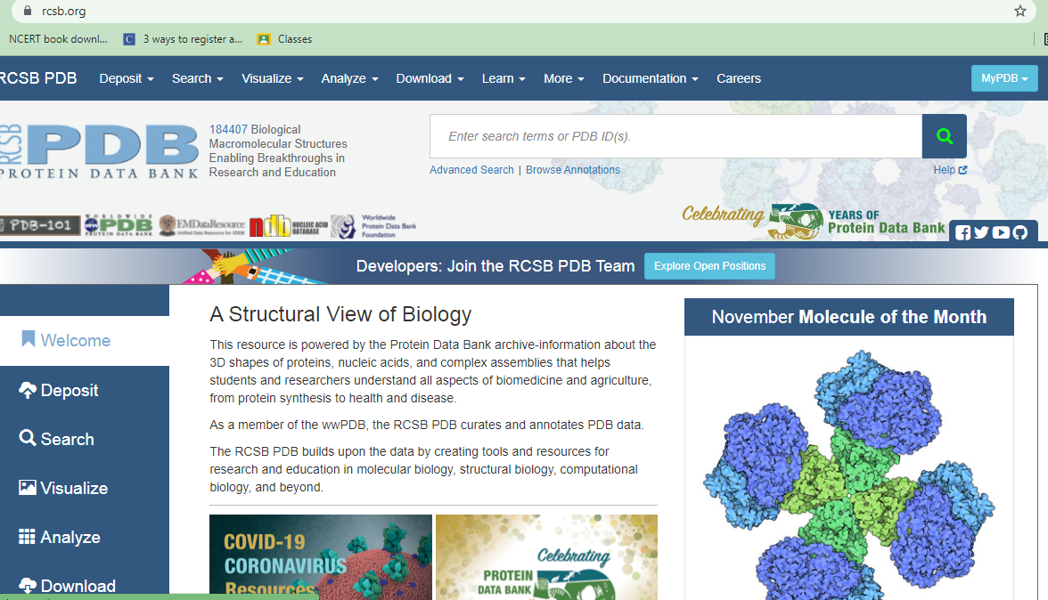
PDB: example

Slide 21
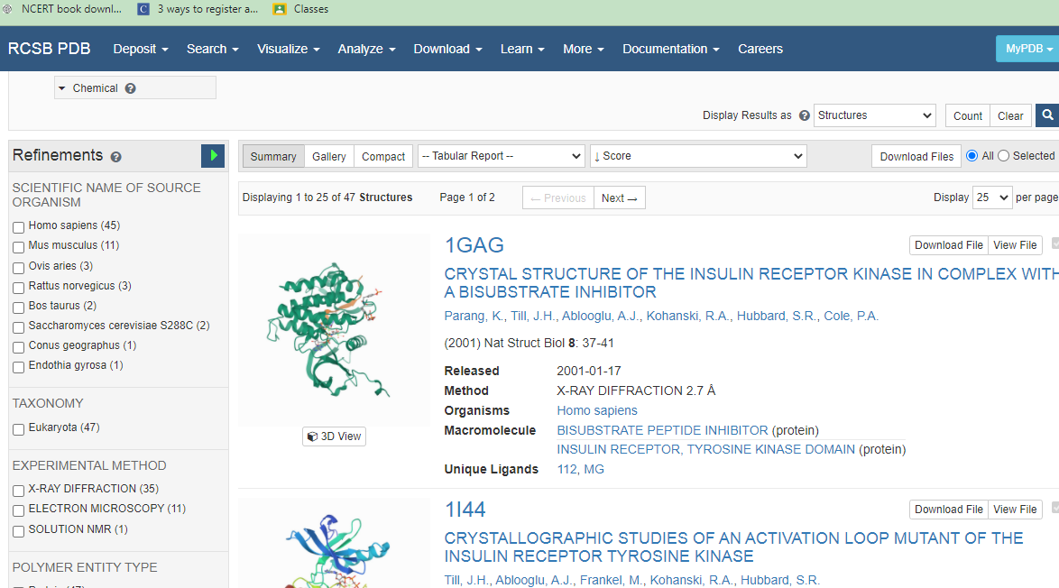

Slide 22
Thank you

